Slide 1
Software Testing
Software Testing lifecycle (STLC)
CYRILL ENDOZO

Slide 2
Course Outline
What is Software Testing?
Importance of Software Testing
What is Software Testing Lifecycle?
Characteristics of STLC
Phases of STLC

Slide 3
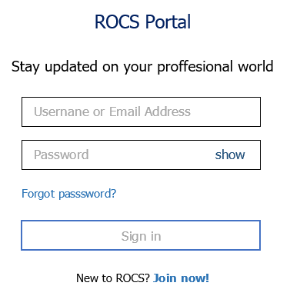
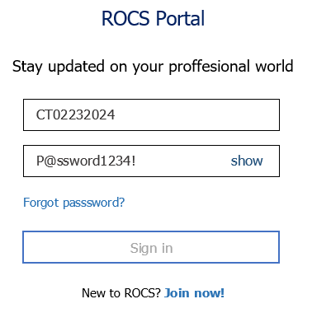
Ice Breaker
Sign in Page
User is trying to sign in

Slide 4
Ice Breaker
Sign in Page
User is trying to sign in
Incorrect spelling. It should be “Professional”
Incorrect spelling. It should be “Username”
Application error. Password field is not encrypted.
It should display “hide” not “show”
Incorrect spelling. It should be “Password”

Slide 5
What is Software Testing?
Software Testing is a method to assess the functionality of the software program. The process checks whether the actual software matches the expected requirements and ensures the software is bug-free.
The purpose of software testing is to identify the errors, faults, or missing requirements in contrast to actual requirements. It mainly aims at measuring the specification, functionality, and performance of a software program or application.

Slide 6
Importance of Software Testing
Defects can be identified early
Improves quality of software
Increased customer satisfaction
Helps with scalability
Saves time and money
Notes:
Defects can be identified early: Software testing is important because if there are any bugs they can be identified early and can be fixed before the delivery of the software.
Improves quality of software: Software Testing uncovers the defects in the software, and fixing them improves the quality of the software.
Increased customer satisfaction: Software testing ensures reliability, security, and high performance which results in saving time, costs, and customer satisfaction.
Helps with scalability: Software testing type non-functional testing helps to identify the scalability issues and the point where an application might stop working.
Saves time and money: After the application is launched it will be very difficult to trace and resolve the issues, as performing this activity will incur more costs and time. Thus, it is better to conduct software testing at regular intervals during software development.

Slide 7
What is Software Testing Lifecycle?
The Software Testing Life Cycle (STLC) is a systematic approach to testing a software application to ensure that it meets the requirements and is free of defects.
It is a process that follows a series of steps or phases, and each phase has specific objectives and deliverables. The STLC is used to ensure that the software is of high quality, reliable, and meets the needs of the end-users.
Notes:
The Software Testing Life Cycle (STLC) is a systematic approach to testing a software application to ensure that it meets the requirements and is free of defects. It is a process that follows a series of steps or phases, and each phase has specific objectives and deliverables. The STLC is used to ensure that the software is of high quality, reliable, and meets the needs of the end-users.
The main goal of the STLC is to identify and document any defects or issues in the software application as early as possible in the development process. This allows for issues to be addressed and resolved before the software is released to the public.
The stages of the STLC include Test Planning, Test Analysis, Test Design, Test Environment Setup, Test Execution, Test Closure, and Defect Retesting. Each of these stages includes specific activities and deliverables that help to ensure that the software is thoroughly tested and meets the requirements of the end users.
Overall, the STLC is an important process that helps to ensure the quality of software applications and provides a systematic approach to testing. It allows organizations to release high-quality software that meets the needs of their customers, ultimately leading to customer satisfaction and business success.

Slide 8
Characteristics of STLC
STLC is a fundamental part of the Software Development Life Cycle (SDLC) but STLC consists of only the testing phases.
STLC starts as soon as requirements are defined or software requirement document is shared by stakeholders.
STLC yields a step-by-step process to ensure quality software.
Notes:
In the initial stages of STLC, while the software product or the application is being developed, the testing team analyzes and defines the scope of testing, entry and exit criteria, and also test cases.
It helps to reduce the test cycle time and also enhances product quality. As soon as the development phase is over, the testing team is ready with test cases and starts the execution. This helps in finding bugs in the early phase.

Slide 9
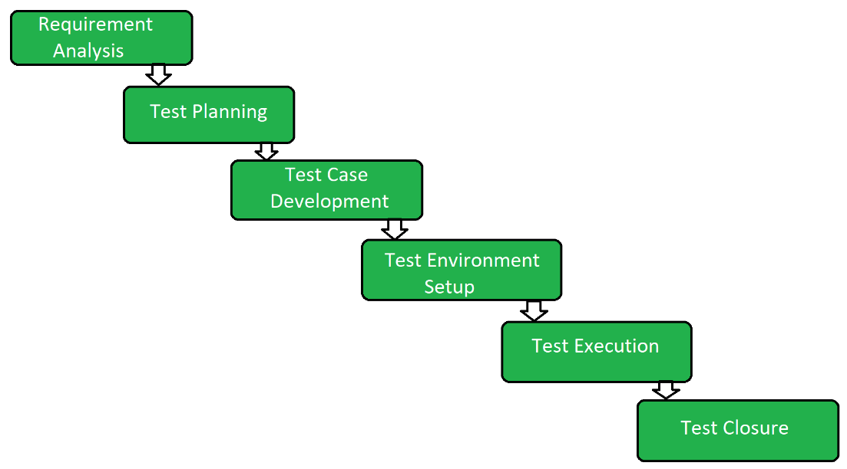
Phases of STLC

Slide 10
Requirements Analysis
Requirement Analysis is the first step of the Software Testing Life Cycle (STLC). In this phase quality assurance team understands the requirements like what is to be tested. If anything is missing or not understandable then the quality assurance team meets with the stakeholders to better understand the detailed knowledge of requirements.

Slide 11
Requirements Analysis
What are the activities during Requirements Analysis?
Reviewing the software requirements document (SRD) and other related documents
Interviewing stakeholders to gather additional information
Identifying any ambiguities or inconsistencies in the requirements
Identifying any missing or incomplete requirements
Identifying any potential risks or issues that may impact the testing process
Notes:
Creating a requirement traceability matrix (RTM) to map requirements to test cases
At the end of this stage, the testing team should have a clear understanding of the software requirements and should have identified any potential issues that may impact the testing process. This will help to ensure that the testing process is focused on the most important areas of the software and that the testing team is able to deliver high-quality results.

Slide 12
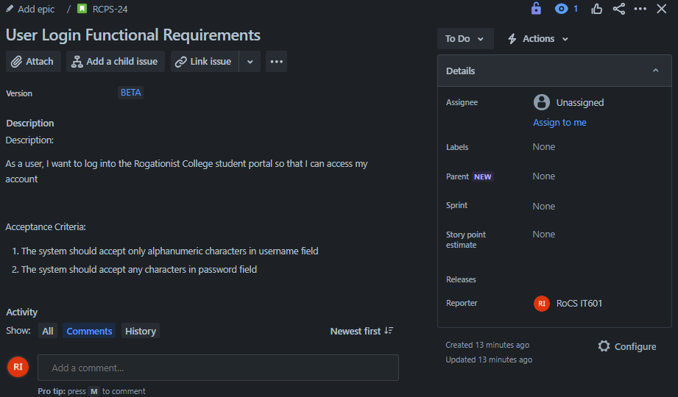
Requirements Analysis
Example of Requirements
A user story is an informal, general explanation of a software feature written from the perspective of the end user
Acceptance criteria (AC) are the conditions a software product must meet to be accepted by a user, a customer, or other systems
Notes:
Creating a requirement traceability matrix (RTM) to map requirements to test cases
At the end of this stage, the testing team should have a clear understanding of the software requirements and should have identified any potential issues that may impact the testing process. This will help to ensure that the testing process is focused on the most important areas of the software and that the testing team is able to deliver high-quality results.

Slide 13
Test Planning
Test Planning is the most efficient phase of the software testing life cycle where all testing plans are defined. In this phase manager of the testing, team calculates the estimated effort and cost for the testing work.
This phase gets started once the requirement-gathering phase is completed.

Slide 14
Test Planning
What are the activities during Test Planning?
Identifying the testing objectives and scope
Developing a test strategy: selecting the testing methods and techniques that will be used
Identifying the testing environment and resources needed
Identifying the test cases that will be executed and the test data that will be used
Estimating the time and cost required for testing
Identifying the test deliverables and milestones
Assigning roles and responsibilities to the testing team
Reviewing and approving the test plan
Notes:
At the end of this stage, the testing team should have a detailed plan for the testing activities that will be performed, and a clear understanding of the testing objectives, scope, and deliverables. This will help to ensure that the testing process is well-organized and that the testing team is able to deliver high-quality results.

Slide 15
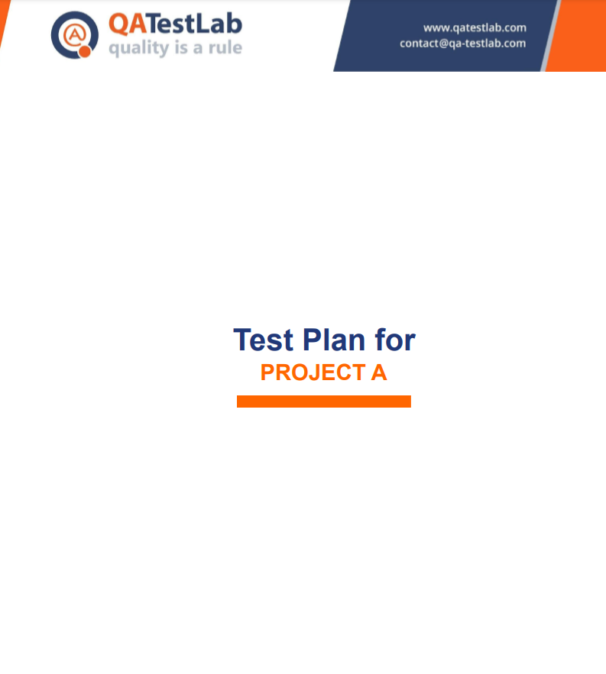
Test Planning
Example of a Test Plan

Slide 16
Test Case Development
The test case development phase gets started once the test planning phase is completed. In this phase testing team notes down the detailed test cases.
The testing team also prepares the required test data for the testing. When the test cases are prepared then they are reviewed by the quality assurance team.

Slide 17
Test Case Development
What is a Test Case?
A test case is a defined format for software testing required to check if a particular application/software is working or not. A test case consists of a certain set of conditions that need to be checked to test an application or software i.e. in more simple terms when conditions are checked it checks if the resultant output meets with the expected output or not.

Slide 18
Test Case Development
Parameters of a Test Case
Module Name
Test Case Id
Tester Name
Test Case Description
Prerequisite
Environment Information
Test Scenario
Test Data
Expected Result
Actual Result
Status
Comments
Notes:
Module Name: Subject or title that defines the functionality of the test.
Test Case Id: A unique identifier assigned to every single condition in a test case.
Tester Name: The name of the person who would be carrying out the test.
Test scenario: The test scenario provides a brief description to the tester, as in providing a small overview to know about what needs to be performed and the small features, and components of the test.
Test Case Description: The condition required to be checked for a given software. for eg. Check if only numbers validation is working or not for an age input box.
Test Steps: Steps to be performed for the checking of the condition.
Prerequisite: The conditions required to be fulfilled before the start of the test process.
Test Priority: As the name suggests gives priority to the test cases that had to be performed first, or are more important and that could be performed later.
Test Data: The inputs to be taken while checking for the conditions.
Test Expected Result: The output which should be expected at the end of the test.
Test parameters: Parameters assigned to a particular test case.
Actual Result: The output that is displayed at the end.
Environment Information: The environment in which the test is being performed, such as the operating system, security information, the software name, software version, etc.
Status: The status of tests such as pass, fail, NA, etc.
Comments: Remarks on the test regarding the test for the betterment of the software.

Slide 19
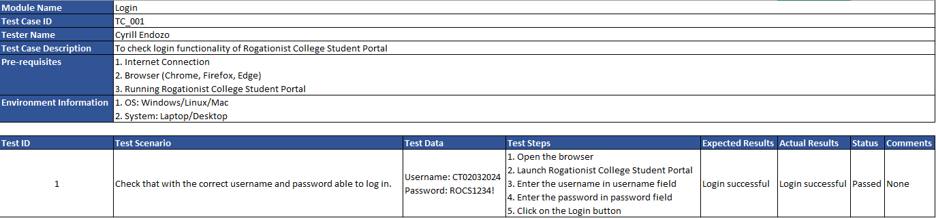
Test Case Development
Example of a Test Case
Notes:
Module Name: Subject or title that defines the functionality of the test.
Test Case Id: A unique identifier assigned to every single condition in a test case.
Tester Name: The name of the person who would be carrying out the test.
Test scenario: The test scenario provides a brief description to the tester, as in providing a small overview to know about what needs to be performed and the small features, and components of the test.
Test Case Description: The condition required to be checked for a given software. for eg. Check if only numbers validation is working or not for an age input box.
Test Steps: Steps to be performed for the checking of the condition.
Prerequisite: The conditions required to be fulfilled before the start of the test process.
Test Priority: As the name suggests gives priority to the test cases that had to be performed first, or are more important and that could be performed later.
Test Data: The inputs to be taken while checking for the conditions.
Test Expected Result: The output which should be expected at the end of the test.
Test parameters: Parameters assigned to a particular test case.
Actual Result: The output that is displayed at the end.
Environment Information: The environment in which the test is being performed, such as the operating system, security information, the software name, software version, etc.
Status: The status of tests such as pass, fail, NA, etc.
Comments: Remarks on the test regarding the test for the betterment of the software.

Slide 20
Test Case Development
What are the activities during Test Case Development?
Identifying the test cases that will be developed
Writing test cases that are clear, concise, and easy to understand
Including positive and negative scenarios
Creating test data and test scenarios that will be used in the test cases
Identifying the expected results for each test case
Reviewing and validating the test cases
Notes:
At the end of this stage, the testing team should have a set of comprehensive and accurate test cases that provide adequate coverage of the software or application. This will help to ensure that the testing process is thorough and that any potential issues are identified and addressed before the software is released.

Slide 21
Test Environment Setup
Test environment setup is a vital part of the STLC. Basically, the test environment decides the conditions on which software is tested. This is independent activity and can be started along with test case development. In this process, the testing team is not involved. either the developer or the customer creates the testing environment.

Slide 22
Test Execution
After the test case development and test environment setup test execution phase gets started. In this phase testing team starts executing test cases based on prepared test cases in the earlier step.

Slide 23
Test Execution
What are the activities during Test Execution?
Test execution
Defect logging
Test data preparation
Test result analysis
Defect retesting
Test Reporting
Notes:
Test execution: The test cases and scripts created in the test design stage are run against the software application to identify any defects or issues.
Defect logging: Any defects or issues that are found during test execution are logged in a defect tracking system, along with details such as the severity, priority, and description of the issue.
Test data preparation: Test data is prepared and loaded into the system for test execution
Test environment setup: The necessary hardware, software, and network configurations are set up for test execution
Test execution: The test cases and scripts are run, and the results are collected and analyzed.
Test result analysis: The results of the test execution are analyzed to determine the software’s performance and identify any defects or issues.
Defect retesting: Any defects that are identified during test execution are retested to ensure that they have been fixed correctly.
Test Reporting: Test results are documented and reported to the relevant stakeholders.
It is important to note that test execution is an iterative process and may need to be repeated multiple times until all identified defects are fixed and the software is deemed fit for release.

Slide 24
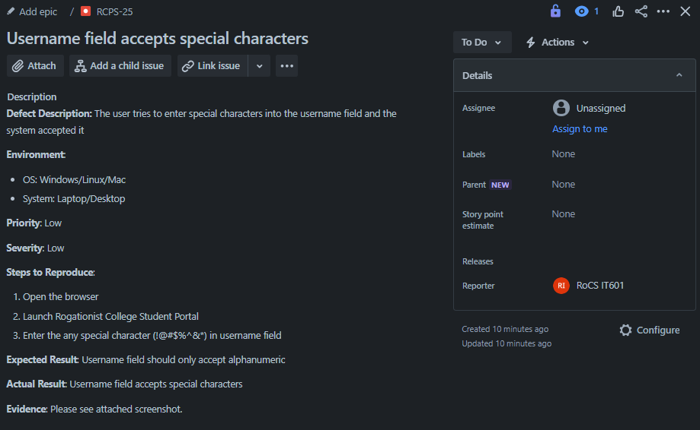
Test Execution
Example of activities under Test Execution
Test execution – Manual or Automation Testing
Defect logging
Notes:
Test execution: The test cases and scripts created in the test design stage are run against the software application to identify any defects or issues.
Defect logging: Any defects or issues that are found during test execution are logged in a defect tracking system, along with details such as the severity, priority, and description of the issue.
Test data preparation: Test data is prepared and loaded into the system for test execution
Test environment setup: The necessary hardware, software, and network configurations are set up for test execution
Test execution: The test cases and scripts are run, and the results are collected and analyzed.
Test result analysis: The results of the test execution are analyzed to determine the software’s performance and identify any defects or issues.
Defect retesting: Any defects that are identified during test execution are retested to ensure that they have been fixed correctly.
Test Reporting: Test results are documented and reported to the relevant stakeholders.
It is important to note that test execution is an iterative process and may need to be repeated multiple times until all identified defects are fixed and the software is deemed fit for release.

Slide 25
Test Execution
Example of activities under Test Execution
Test data preparation
For login
Username: CT02032024
Password: ROCS1234!
Test result analysis
Defect retesting
Retest once defect has been fixed
RCPS-25
Notes:
Test execution: The test cases and scripts created in the test design stage are run against the software application to identify any defects or issues.
Defect logging: Any defects or issues that are found during test execution are logged in a defect tracking system, along with details such as the severity, priority, and description of the issue.
Test data preparation: Test data is prepared and loaded into the system for test execution
Test environment setup: The necessary hardware, software, and network configurations are set up for test execution
Test execution: The test cases and scripts are run, and the results are collected and analyzed.
Test result analysis: The results of the test execution are analyzed to determine the software’s performance and identify any defects or issues.
Defect retesting: Any defects that are identified during test execution are retested to ensure that they have been fixed correctly.
Test Reporting: Test results are documented and reported to the relevant stakeholders.
It is important to note that test execution is an iterative process and may need to be repeated multiple times until all identified defects are fixed and the software is deemed fit for release.

Slide 26
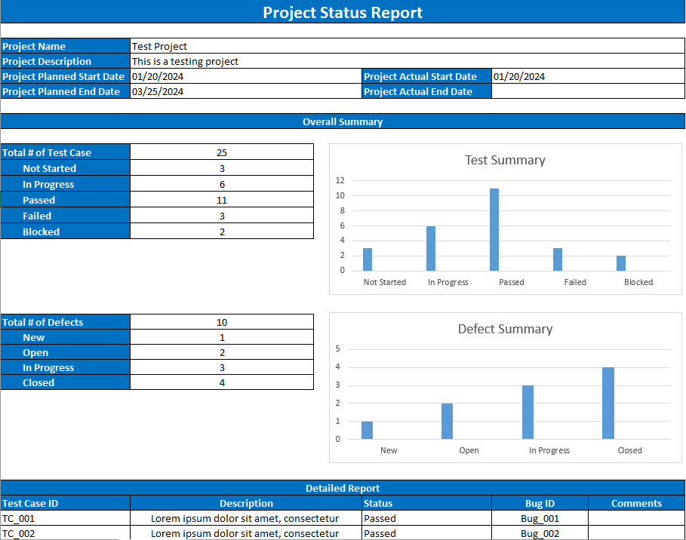
Test Execution
Example of activities under Test Execution
Test Report
Notes:
Test execution: The test cases and scripts created in the test design stage are run against the software application to identify any defects or issues.
Defect logging: Any defects or issues that are found during test execution are logged in a defect tracking system, along with details such as the severity, priority, and description of the issue.
Test data preparation: Test data is prepared and loaded into the system for test execution
Test environment setup: The necessary hardware, software, and network configurations are set up for test execution
Test execution: The test cases and scripts are run, and the results are collected and analyzed.
Test result analysis: The results of the test execution are analyzed to determine the software’s performance and identify any defects or issues.
Defect retesting: Any defects that are identified during test execution are retested to ensure that they have been fixed correctly.
Test Reporting: Test results are documented and reported to the relevant stakeholders.
It is important to note that test execution is an iterative process and may need to be repeated multiple times until all identified defects are fixed and the software is deemed fit for release.

Slide 27
Test Closure
Test closure is the final stage of the Software Testing Life Cycle (STLC) where all testing-related activities are completed and documented. The main objective of the test closure stage is to ensure that all testing-related activities have been completed and that the software is ready for release.
Notes:
Test closure is the final stage of the Software Testing Life Cycle (STLC) where all testing-related activities are completed and documented. The main objective of the test closure stage is to ensure that all testing-related activities have been completed and that the software is ready for release.
At the end of the test closure stage, the testing team should have a clear understanding of the software’s quality and reliability, and any defects or issues that were identified during testing should have been resolved. The test closure stage also includes documenting the testing process and any lessons learned so that they can be used to improve future testing processes
Test closure is the final stage of the Software Testing Life Cycle (STLC) where all testing-related activities are completed and documented. The main activities that take place during the test closure stage include:

Slide 28
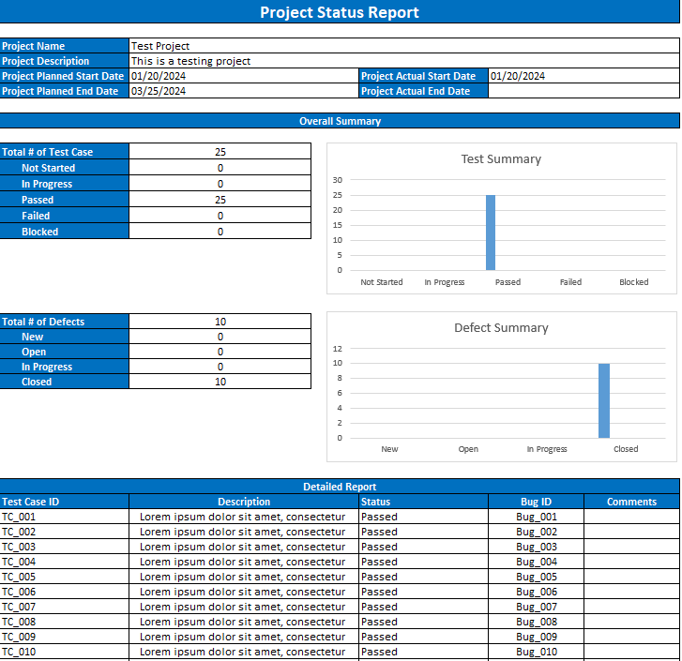
Test Closure
What are the activities during Test Closure?
Test summary report
Defect tracking
Test closure report
Knowledge transfer
Notes:
Test summary report: A report is created that summarizes the overall testing process, including the number of test cases executed, the number of defects found, and the overall pass/fail rate.
Defect tracking: All defects that were identified during testing are tracked and managed until they are resolved.
Test environment clean-up: The test environment is cleaned up, and all test data and test artifacts are archived.
Test closure report: A report is created that documents all the testing-related activities that took place, including the testing objectives, scope, schedule, and resources used.
Knowledge transfer: Knowledge about the software and testing process is shared with the rest of the team and any stakeholders who may need to maintain or support the software in the future.
Feedback and improvements: Feedback from the testing process is collected and used to improve future testing processes
It is important to note that test closure is not just about documenting the testing process, but also about ensuring that all relevant information is shared and any lessons learned are captured for future reference. The goal of test closure is to ensure that the software is ready for release and that the testing process has been conducted in an organized and efficient manner.

Slide 29
Activity

Slide 30
Given the requirements …
Description:
As a user, I want to log into the Rogationist College student portal so that I can access my account
Acceptance Criteria:
The system should display RC logo
The system should display “RC Student’s Portal” label
The system should display “Please sign in with your account..” label
The system should accept only alphanumeric characters in username field
The system should accept any characters in password field
Password entered should be encrypted
Login button should be enabled
The system should perform successful login when valid username and password are entered and Sign In button is click
The system should throw an error “Invalid Login Credentials” when username entered is incorrect
The system should throw an error “Invalid Login Credentials” when password entered is incorrect
The system should throw an error “Invalid Login Credentials” when username and password entered are incorrect
When forgot password is click, user should be redirected to Recover Password Facility page
When No Account? Create One. is click, user should be redirected to Member's Registration Facility page

Slide 31
Write as many test cases as you can using the Rogationist College Student Portal
Include both positive and negative scenarios
Present your written test case
Execute the test case you’ve created

Slide 32
REFERENCE
https://www.geeksforgeeks.org/software-testing-basics/
https://www.geeksforgeeks.org/test-case/
https://www.geeksforgeeks.org/software-testing-life-cycle-stlc/

